Slide 1
Operators
Rajasekaran S
Assistant Professor,
Department of Information Technology,
KGiSL Institute of Technology,
email: proffraja@gmail.com
Github:www.github.com/rajasekaranap

Slide 2
Operator Types
Unary Operator,
Arithmetic Operator,
Shift Operator,
Relational Operator,
Bitwise Operator,
Logical Operator,
Ternary Operator and
Assignment Operator.

Slide 3
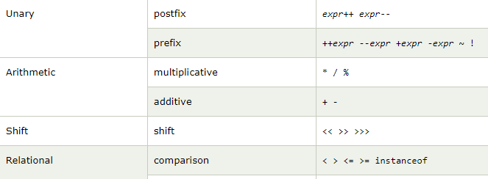
Operators

Slide 4
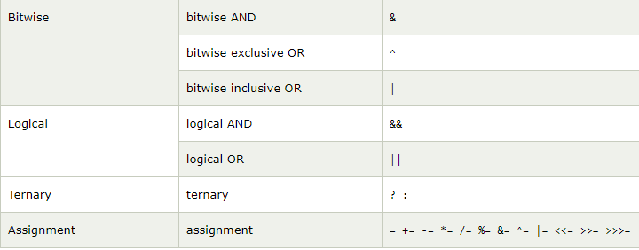
Operators

Slide 5
Thank You
Rajasekaran S
Assistant Professor,
Department of Information Technology,
KGiSL Institute of Technology,
email: proffraja@gmail.com
Github:www.github.com/rajasekaranap

